Slide 1


B
University IT Issues
Tracking System
Page | 1

Slide 2







TEAM:114
Meet Our Best Team Here
Laharika
Sai
Sri Deepthi
Rohit
Nikitha
Vamsi
Page | 2

Slide 3
01
Problem Identification
02
User creation & assigning roles
03
Incident Management
04
Change Management
Table of
Content
05
Problem Management
06
Notifications
07
Visual Task Boards
08
Virtual Agent (chatbot)
Page | 3

Slide 4
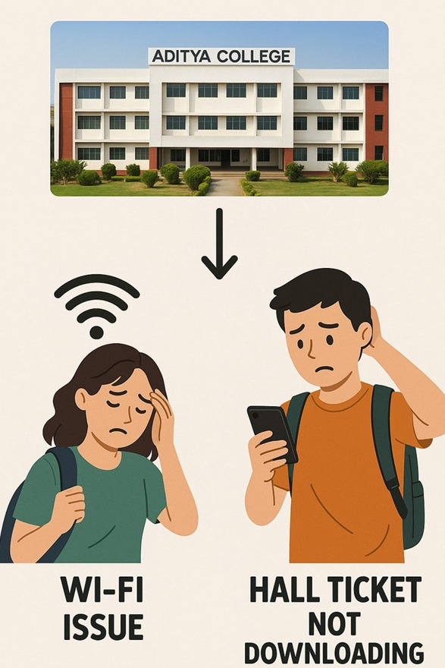
Problem Identification
University IT issues like slow Wi-Fi, login errors, and document download failures often frustrate students and staff.
Without a proper tracking system, these problems go unnoticed or unresolved, leading to delays and repeated complaints.
A centralized, automated platform is essential to ensure faster resolutions and a smoother user experience
Page | 3

Slide 5
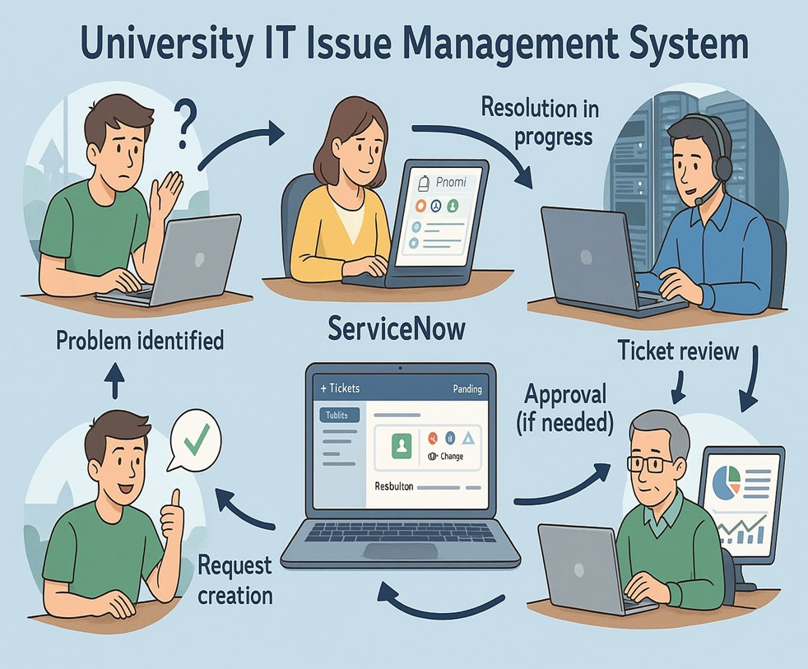
Prototype
To solve these issues, we built a University IT Issue Management prototype using ServiceNow.
It helps users quickly raise tickets, track their progress, and get fast solutions.
With features like Incident, Change, and Problem Management, real-time dashboards, alerts, and a smart chatbot, it ensures smooth communication and faster IT support on campus.
Page | 4

Slide 6
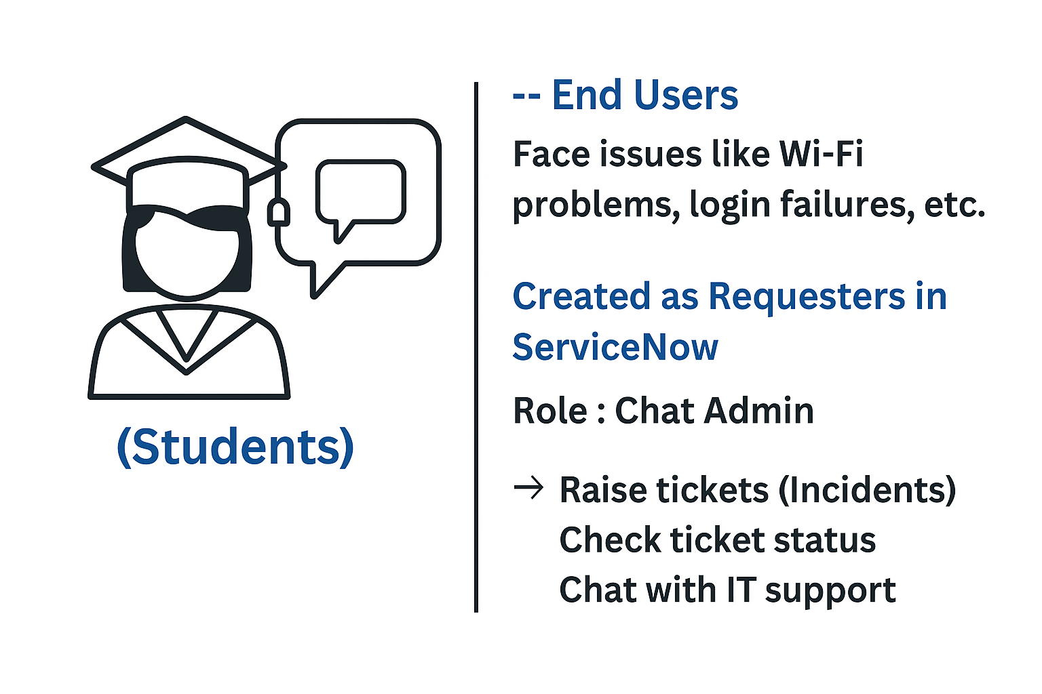
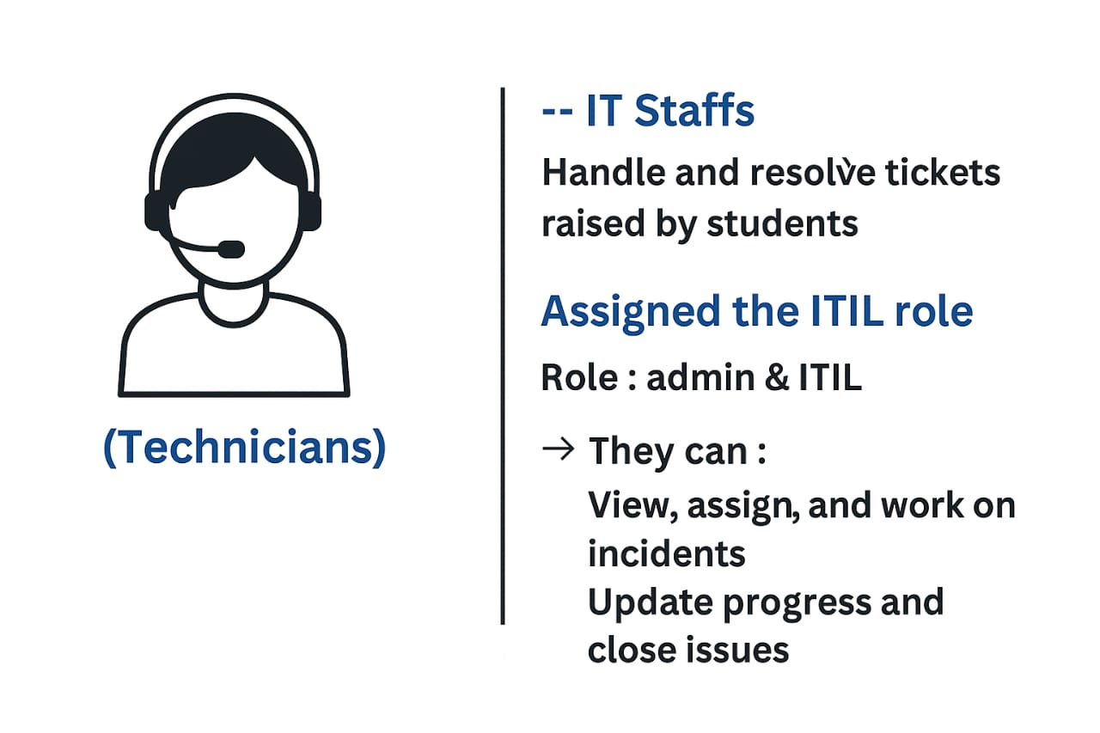
User creation and assigning of roles
Page | 6

Slide 7
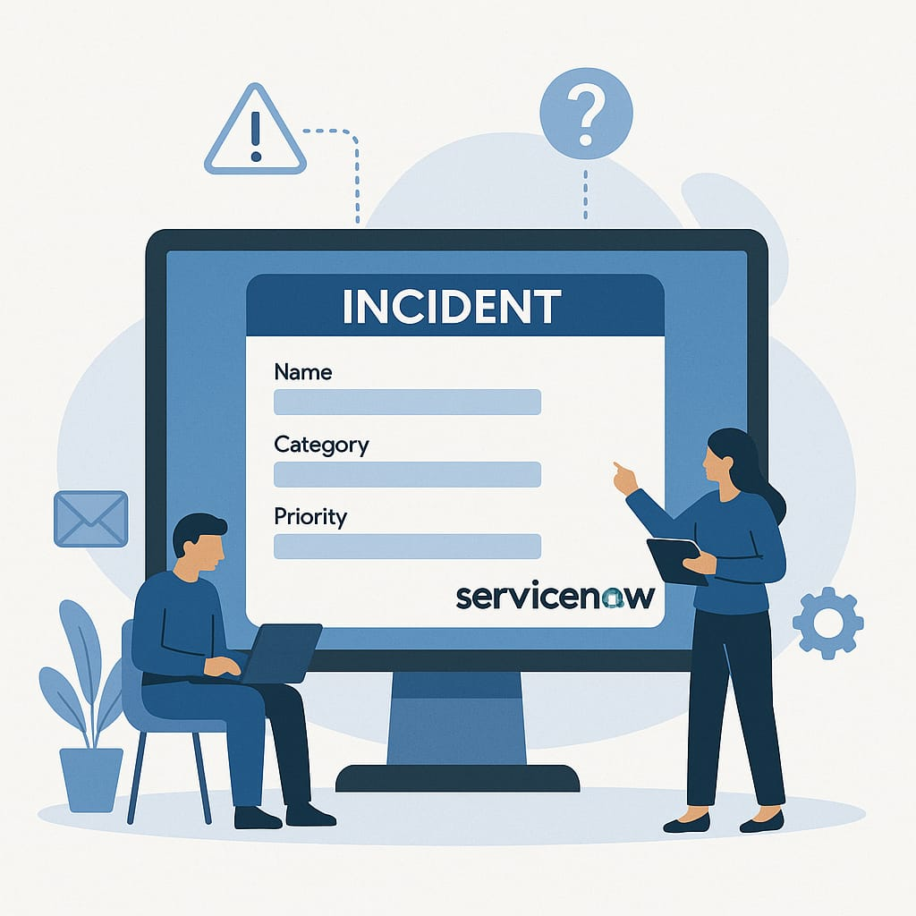
Incident Management
Handle unexpected IT issues like system errors, login failures, or Wi-Fi problems that disrupt user activities.
When a user reports a problem by raising a ticket, it is automatically assigned to the IT support team.
→ Key Insight :
The team investigates the issue and communicates with user ensuring quick service recovery and minimal disruption.
Automation
Page | 7

Slide 8
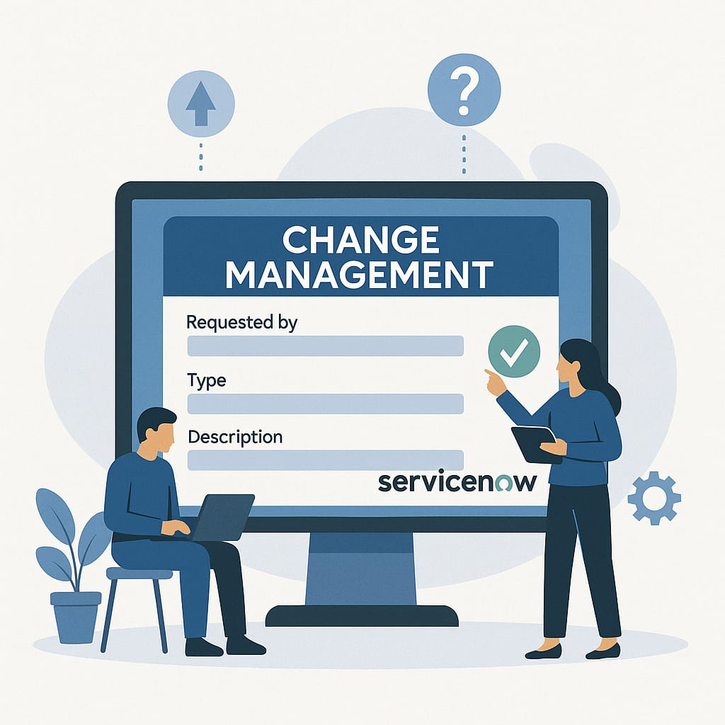
Change Management
Change Management is used to safely make changes in the IT system.
The IT team creates a change request and chooses the type:
Standard --- (simple updates)
Normal --- (needs planning and approval)
Emergency --- (urgent fixes).
Key Insight :
Once approved, the change is applied and reviewed to make sure everything works smoothly.
Automation
Page | 8

Slide 9
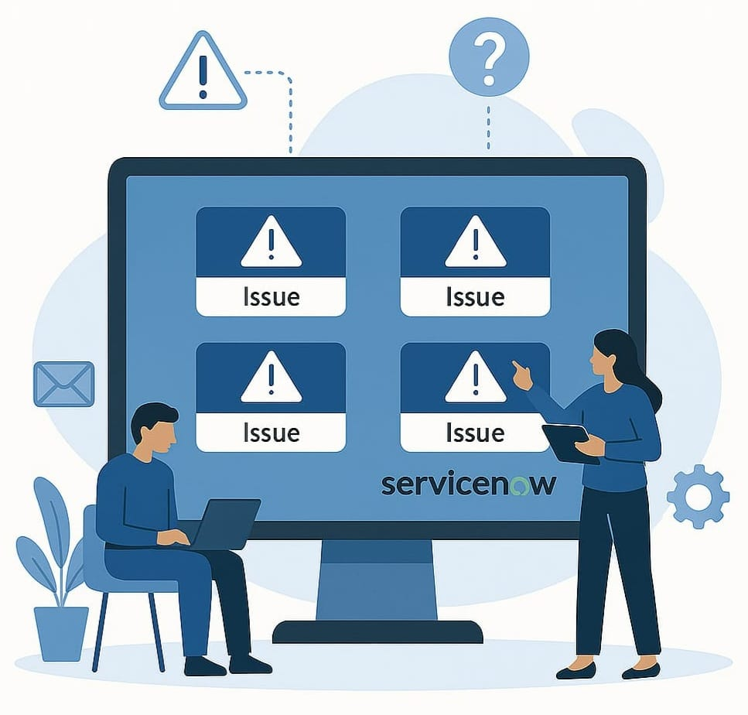
Problem Management
Incident Reporting
Students from Block B report repeated Wi-Fi issues.
Multiple Incidents logged in ServiceNow.
Problem Detection & Investigation
IT team identifies recurring pattern → Creates a Problem Ticket.
Root Cause Analysis done → Faulty network switch found.
It aims to find and fix the root cause of repeated incidents to prevent them from happening again. In our project this process improves service reliability for students and staff.
Resolution & Prevention
Switch replaced → Issue resolved.
Page | 9

Slide 10
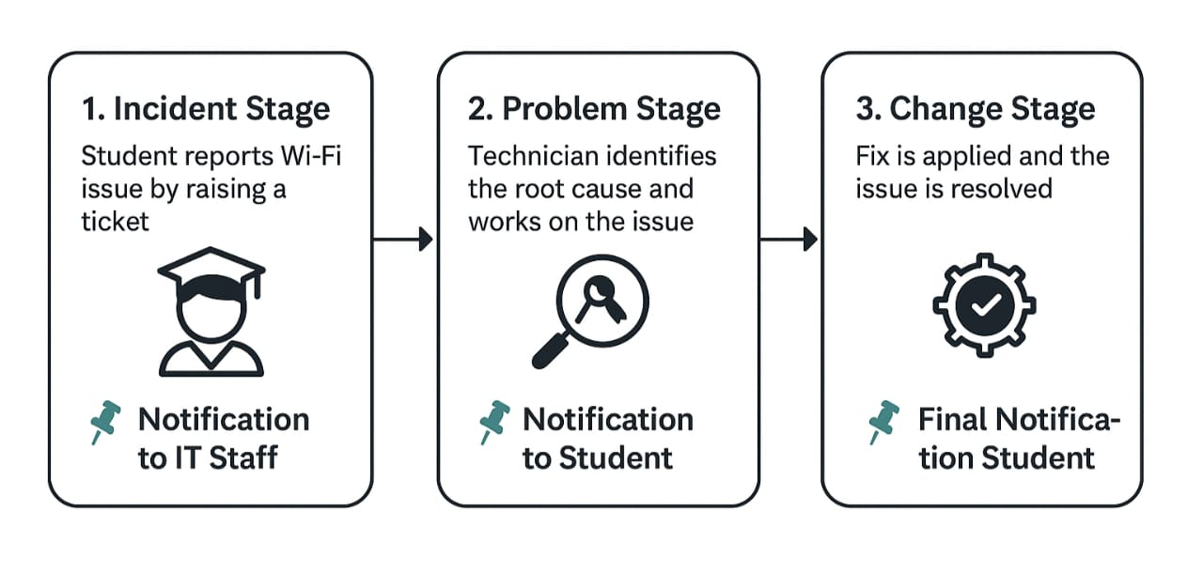
Notifications
Page | 10

Slide 11
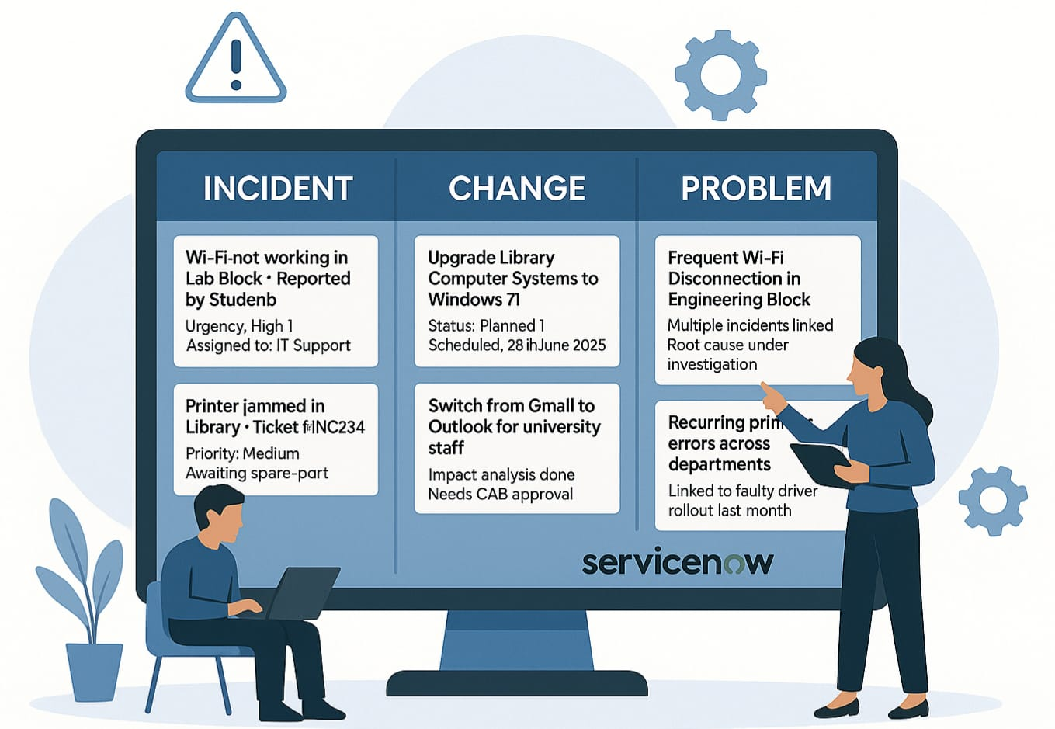
Visual Task Boards
All new student-reported issues
shown as cards under columns like:
🟦 To Do
🟨 In Progress
🟩 Resolved
Complex issues are tracked on a separate Visual Task Board with stages like Investigation, Root Cause, Solution, and Closure.
Change requests are tracked through stages:
Draft → Awaiting Approval → Implementing → Completed
Page | 11

Slide 12
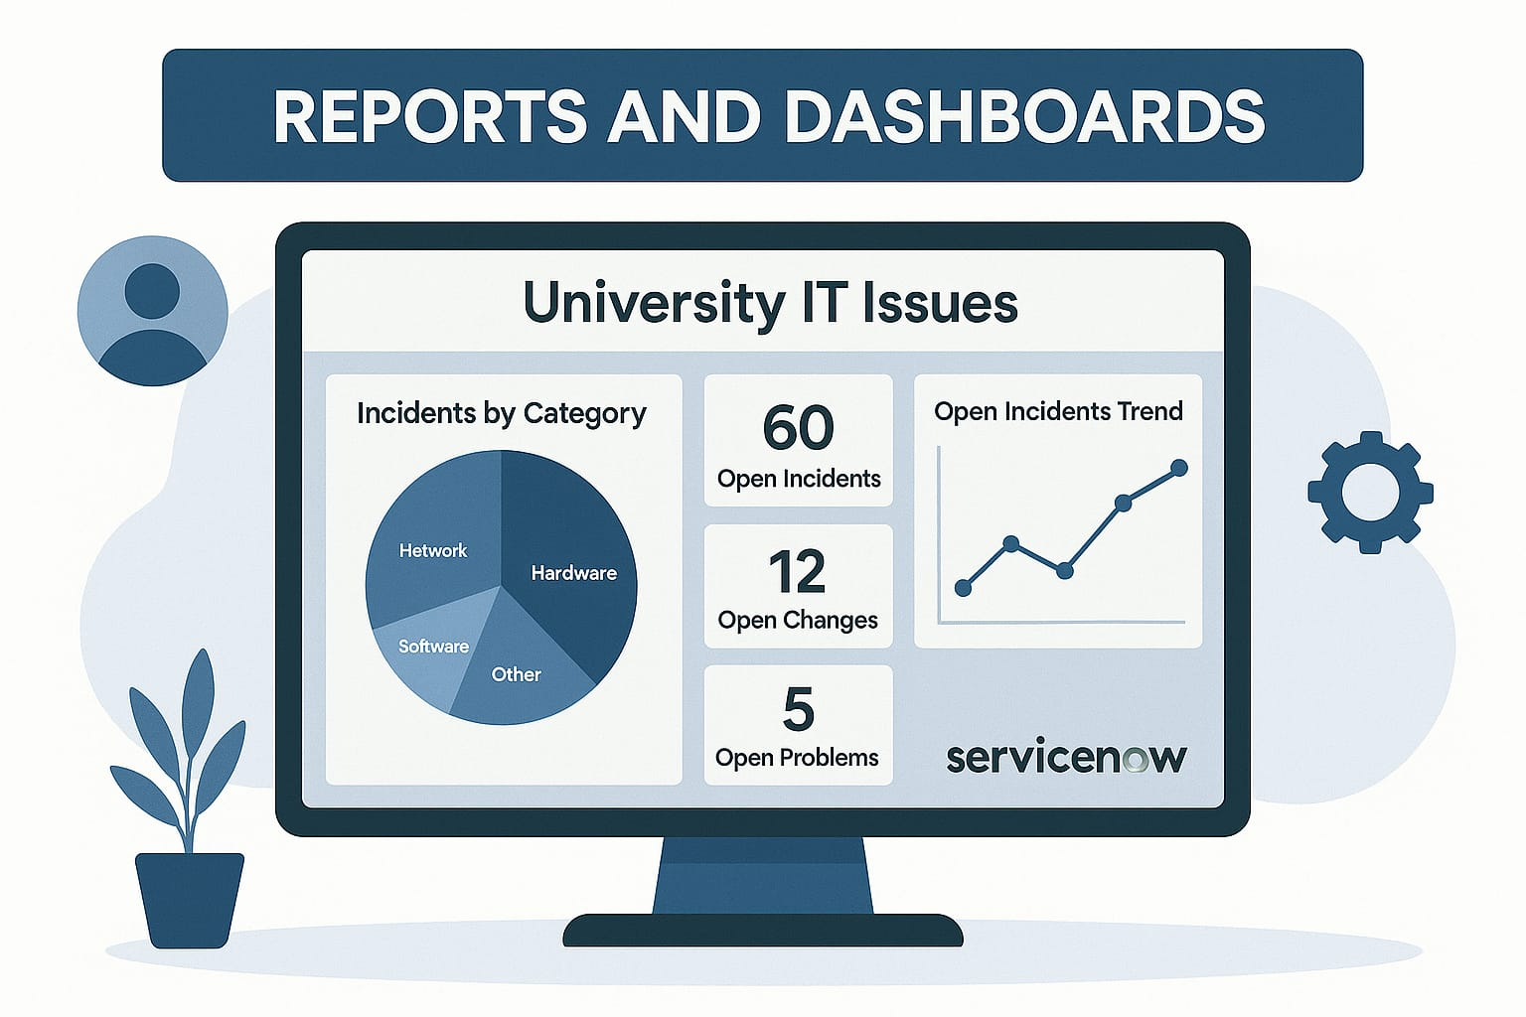
Reports and dashboards
Dashboards show live status of incidents, problems, and changes (e.g., open tickets, resolved issues).
📊
Reports highlight frequent issue to identify patterns and root causes
📈
Track IT team performance using metrics like resolution time, ticket volume, and SLA compliance.
📝
Page | 12

Slide 13

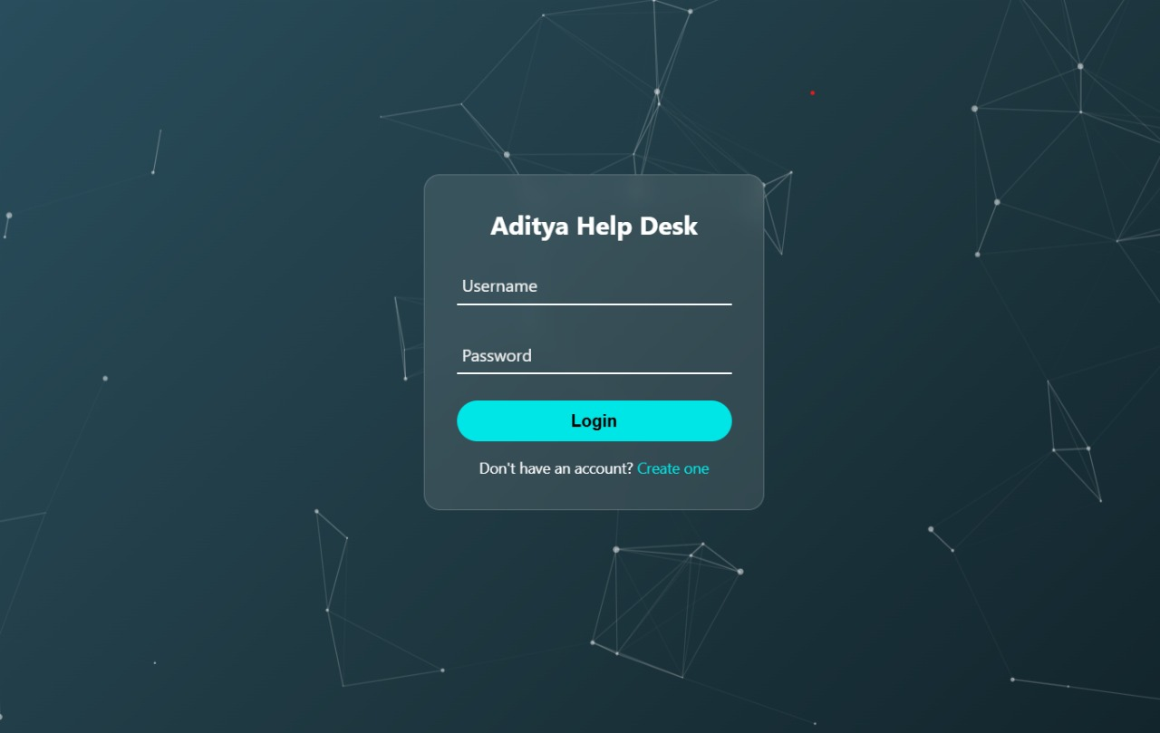
Virtual Agent
📨
24/7 Automated Support:
The Virtual Agent provides instant, conversational assistance to users, reducing the need for human intervention in common service requests.
Integrated with ServiceNow Platform:
Seamlessly interacts with ServiceNow data and modules (like Incident, Knowledge, and Custom APIs) to deliver personalized and intelligent responses.
🤖
Page | 13

Slide 14

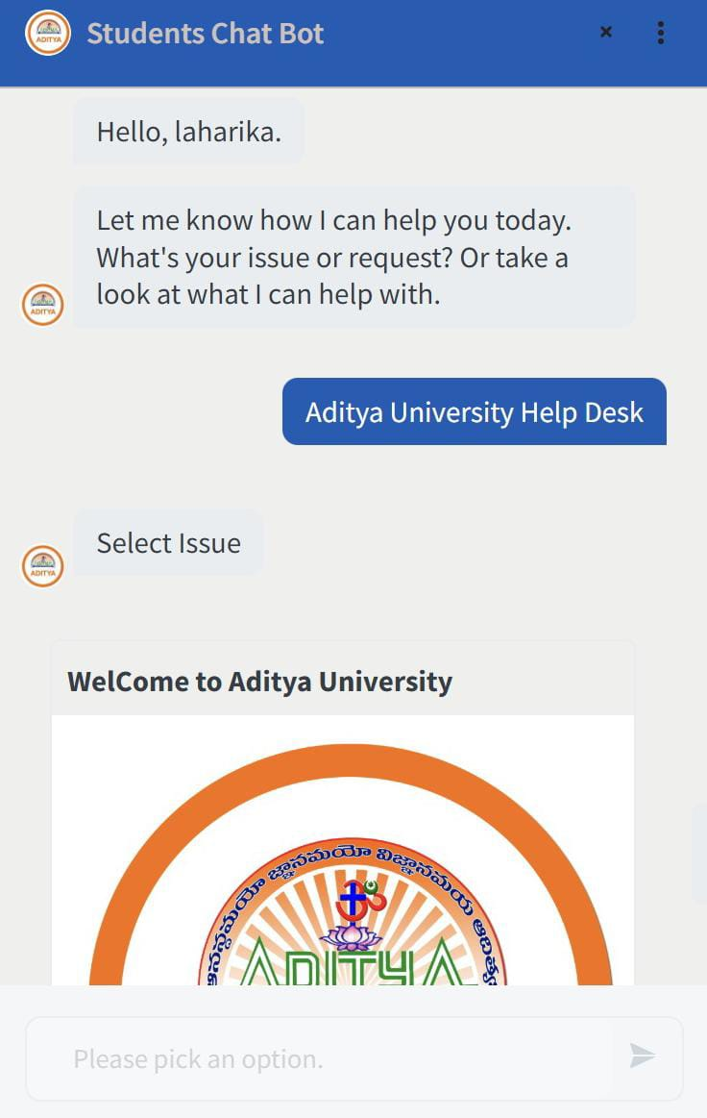
Chatbot
🤖
Smart Query Handling:
The chatbot understands and responds to student queries instantly using natural language processing, improving user engagement and efficiency.
Custom Integration:
Integrated with a custom login system and ServiceNow backend to deliver personalized responses based on student roll numbers.
🔗
Page | 14

Slide 15
Why to choose servicenow for this project ?
Real-Time, Industry-Relevant Experience
Gain real-world ITSM experience with ServiceNow, a platform used by top enterprises.
Faster Development with Powerful Built-in Tools
Build faster using ServiceNow’s built-in tools, avoiding full-stack complexity
Page | 15

Slide 16
Thank you
Page | 16

